Slide 1
Class And Object
Course Code:
Course Title: Object Oriented Programming -1(JAVA)
Dept. of Computer Science
Faculty of Science and Technology
Lecturer No: | 2.2 | Week No: | 2 | Semester: | Summer 19-20
Lecturer: | RIFATH MAHMUD

Slide 2
Lecture Outline
Class definition
Object definition
Defining a Class
Defining Instance Variables
Defining Instance Methods
Instance Methods Visibility
Instance Methods body
Returning value from a method
class as a type
Initializing object reference
Invoking instance method
Constructor
Converting a c++ code to java

Slide 3
Class and Object
Class definition
Classes are templates or blueprints for Objects
Data and methods are defined within Classes
Classes must provide an implementation such that objects created from those classes behave as those defined in the Object model.

Slide 4
Class And Object
Definition of object
An Object is the appearance of a class
An object is an Instance of a class
The process of creating an object is called instantiation
The attributes of an object are called instance variables
The methods of an object are called instance methods
In Java, Objects are created using the new keyword:
Employee anEmployee = new Employee();

Slide 5
Defining a Class
A class definition must have the following:
The keyword "class" followed by the name of the class
The class body
Before the keyword "class" there is a optional modifier "public"
If a class is public, it must be defined within a file which is the same name as the class with a ".java" extension.
i.e. Classname.java
eg. HelloWorld.java, Account.java, Ledger.java, Transaction.java
Most classes are declared public
The class body contains:
Zero or more instance variables
Zero or more methods

Slide 6
Defining Instance Variables
Instance variables are declared using the same syntax as ordinary variables.
Variables can be prefixed with a visibility/access modifier
Variables can have one of 4 different visibilities:
public - the variable can be directly accessed from anywhere
private - the variable can only be directly accessed from within the class
protected - the variable can be access directly from within the class, within the package, or from within any subclass.
default (no modifier specified) - the variable can be accessed directly from within the package
// We will discuss in details later.
modifier type variable_name;

Slide 7
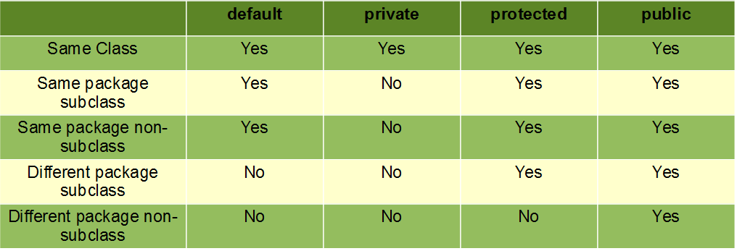
Access Specifiers/modifiers

Slide 8
Defining Instance Methods
Method definitions include a method signature and a method body.
Methods signatures are defined with the following syntax:
The return type can be:
a fundamental data type
an object reference
void (no return)
Parameters are optional
If the method takes no parameters, empty brackets are required ()
Multiple parameters are separated by commas
Parameters are defined by type and name
A parameter is a local variable whose scope is the method.
modifier return_type method_name(type name, ...)

Slide 9
Defining Instance Methods Visibility
Methods have the same visibility modifiers as variables
public - the method can be invoked from anywhere
private - the method can only be invoked from within the class
protected - the method can be invoked directly from within the class, within the package, or from within any subclass.
default (no modifier specified) - the method can be invoked directly from within the package
// we will discuss in detail later.
If a method is part of the class's public interface (external view), the method should be public
If a method is part of the class's internal implementation (ie, support method, etc), it should be private.
Be careful using default or protected. Use only when justified.

Slide 10
Defining Instance Methods - Body
A method's body contains all the statements to be executed as part of the method
The method body is contained within curly braces after the method definition:
Use {} placement and indentation to clearly show code structure
public class CalculationSheet
{
public void performCalculations()
{
//... method body ...
}
public void clearSheet()
{
}
//...Rest of the code...
}

Slide 11
Returning values from methods
A method which has a non-void return type MUST return a value
The return value's type must match the type defined in the method's signature.
A void method can use a return statement (with no return value) to exit the method.
The return value can be used the same as any other expression.
public class Car
{
private int currentGear;
private int currentRpms;
public int calculateSpeed()
{
return currentRpms * currentGear;
}
}

Slide 12
Classes as types
When a class is defined, the compiler view the class as a new type.
When a variable is declared, its type can be a primitive type or "Class" type.
Any variable whose type is a class is an object reference.
The variable is a reference to an instance of the specified class.
The variables holds the address (in memory) of the object.
int x;
Employee anEmployee;
0
null
Note: null means “refers to no object”

Slide 13
null References
null means “refers to no object"
Object references can be compared to null to see if an object is present or not.
null is the default value of an object reference before it is initialized
Employee anEmployee;
if (anEmployee == null){
//
}

Slide 14
Initializing Object References - new
To initialize an object reference, you must assign it the address of an object
The new operator creates a new instance and returns the address of the newly created object
new allocates memory for the object
new also invokes a method on the object called a constructor
new returns the address of the memory allocated for the object.
Employee anEmployee;
anEmployee = new Employee();

Slide 15
Invoking Instance Methods
To invoke a method on an object, use the . (dot) operator
If there is a return value, it can be used as an expression
objectReference.methodName(parameters);
Car aCar = new Car();
if ( aCar.calculateSpeed() > 110 )
{
System.out.println("You're Speeding!");
}

Slide 16
Passing Parameters to Methods
Method parameters are declared in the method's signature.
When a method invocation is made, any parameters included in the invocation are passed to the method
All parameters are passed by value. i.e, a copy is made
The value of fundamental data types are copied
The value of object references (i.e, memory addresses) are copied
Parameters become available within the method. They are not known outside the method.
public float calculateInterestForMonth(float rate)
{
return lowBalanceForMonth * (rate/12.0);
}

Slide 17
Initializing Objects - Constructors
When an object is created, all instance variables are initialized to the default value for their type
Fundamentals are 0, 0.0, '\000' or false
Object references are null
In order to put the object into a usable state, its instance variables should be initialized to usable values
This could be accomplished by calling the various set methods
This is not always possible because it is not required that all instance variables have set methods.
Java provides for another method of initializing objects
When an object is created, a constructor is invoked. The responsibility of the constructor method is to initialize the object into a usable state.

Slide 18
Constructors
Constructors have the following characteristics
There is NO return type. NOT even void
The method name is the same name as the class name
Constructors can be overloaded

Slide 19
Constructors - Example
public class BankAccount
{
String ownersName;
int accountNumber;
float balance;
public BankAccount()
{
}
public BankAccount(int anAccountNumber)
{
accountNumber = anAccountNumber;
}
public BankAccount(int anAccountNumber, String aName)
{
accountNumber = anAccountNumber;
ownersName = aName;
}
}

Slide 20
Constructors - Example
When an object is created (using new) the compiler determines which constructor is to be invoked by the parameters passed
Multiple constructors allows the class programmer to define many different ways of creating an object.
public static void main(String[] args)
{
BankAccount anAccount = new BankAccount();
BankAccount anotherAccount = new BankAccount(12345);
BankAccount myAccount = new BankAccount(33423, "Craig");
}

Slide 21
Constructors
If no constructors are defined for a class, the compiler automatically generates a default, no argument constructor
All instance variables are initialized to default values.
However, if any constructor is defined which takes parameters, the compiler will NOT generate the default, no argument constructor
If you still need one, you have to explicitly define one.

Slide 22
Converting a C++ code to java (C++ Version)
#include <iostream>
using namespace std;
class Person{
private:
int id;
string name;
public:
Person() {
}
Person(int i,string n) {
id=i;
name=n;
}
void displayInfo() {
cout<<"Name is :"<<name<<endl;
cout<<"Id is :"<<id<<endl;
}
};
int main()
{
Person p1(101,"Mashrafi");
p1.displayInfo();
return 0;
}

Slide 23
Converting a C++ code to java (Java Version)
public class Person
{
private int id;
private String name;
public Person()
{
}
public Person(int i,String n)
{
id=i;
name=n;
}
public void displayInfo()
{
System.out.println("Name is :"+name);
System.out.println("Id is :"+id);
}
public static void main(String args[])
{
Person p1=new Person(101,"Mashrafi");
p1.displayInfo();
}
}

Slide 24
Books
1. Java Complete Reference, 7th Edition, By Herbert Schildt.
2. A Programmer's Guide to Java SE 8 Oracle Certified Associate, Khalid A. MughalRolf W. Rasmussen
3. Java How to Program Java, 9th Edition, By Deitel and Deitel.
4. The Java Language Specification, By J. Gosling, B. Joy, G. Steele, G.Bracha and A. Buckley
5. Introduction to Programming Using Java, 6th Edition, By David j. Eck
6. Head First Java, By Kathy Sierra and Bert Bates

Slide 25
References
1. 1. Java Complete Reference, 7th Edition, By Herbert Schildt.
2. A Programmer's Guide to Java SE 8 Oracle Certified Associate, Khalid A. MughalRolf W. Rasmussen
2. The Java Tutorials. http://docs.oracle.com/javase/tutorial/

